Slide 1
SENSORS

Slide 2
What is a Sensor??
An input device which provides an output (signal) with respect to a specific physical quantity (input).
A device that converts signals from one energy domain to electrical domain.

Slide 3
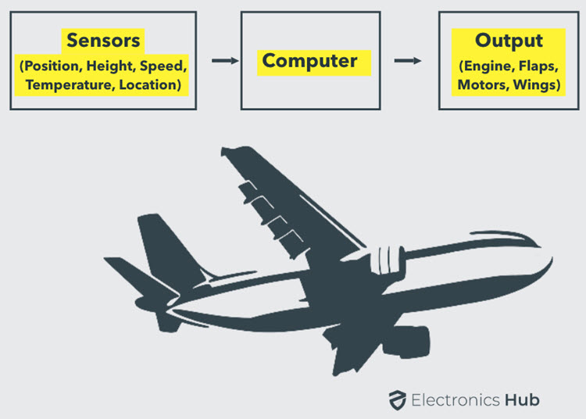
Autopilot System

Slide 4
CLASSIFICATION OF SENSORS
BASED ON:-
POWER SOURCE
OUTPUT
Active Sensors
Passive Sensors
https://gisgeography.com/passive-active-sensors-remote-sensing/
Analog Sensors
https://www.watelectrical.com/what-are-analog-sensors-types-and-their-characteristics/
Digital Sensors
https://www.watelectrical.com/what-are-digital-sensors-types-and-their-uses/

Slide 5
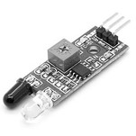
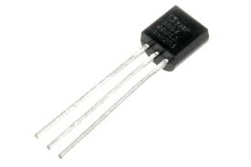
TYPES OF SENSORS
Temperature Sensor
IR Sensor

Slide 6
ACTIVE SENSORS
An active sensor is a sensing device that requires an external source of power to operate; active sensors contrast with passive sensors, which simply detect and respond to some type of input from the physical environment.
In the context of remote sensing, an active sensor is a device with a transmitter that sends out a signal, light wavelength or electrons to be bounced off a target, with data gathered by the sensor upon their reflection.

Slide 7
PASSIVE SENSORS
Remote sensing systems which measure energy that is naturally available are called passive sensors. Passive sensors can only be used to detect energy when the naturally occurring energy is available. For all reflected energy, this can only take place during the time when the sun is illuminating the Earth.

Slide 8
ANALOG SENSORS
Analog sensors are the devices that produce analog output in correspondence to the quantity being calculated. These sensors also observe the change in external factors such as light intensity, speed of the wind, and solar radiation, and others. And the output ranges between 0V to 5V. Here, Logic 1 corresponds to the voltage level of 3.5V to 5V and Logic 0 corresponds to the voltage level of 0V to 3.5V.
For instance, the temperature range of a liquid can be known either by thermocouple or thermometer that constantly responds to temperature change either the liquid is cooled or heated.

Slide 9
DIGITAL SENSORS
Digital sensors are the kind of electrochemical or electrical sensors where the information is converted to digital form and then transmitted. The output of a digital sensor is the distinct digital signal of the quantity which is being measured. And the measured quantities might be of conductivity, pH value, redox potentials, and many others. The output is in the form of 1’s and 0’s where ‘1’ represents ON condition and ‘0’ represents OFF condition. This corresponds that a digital signal generates distinct (non-continuous) values and the output is considered either as a single “bit”, (serial transmission) or the combination of multiple bits called “byte” and is called (parallel transmission).

Slide 10
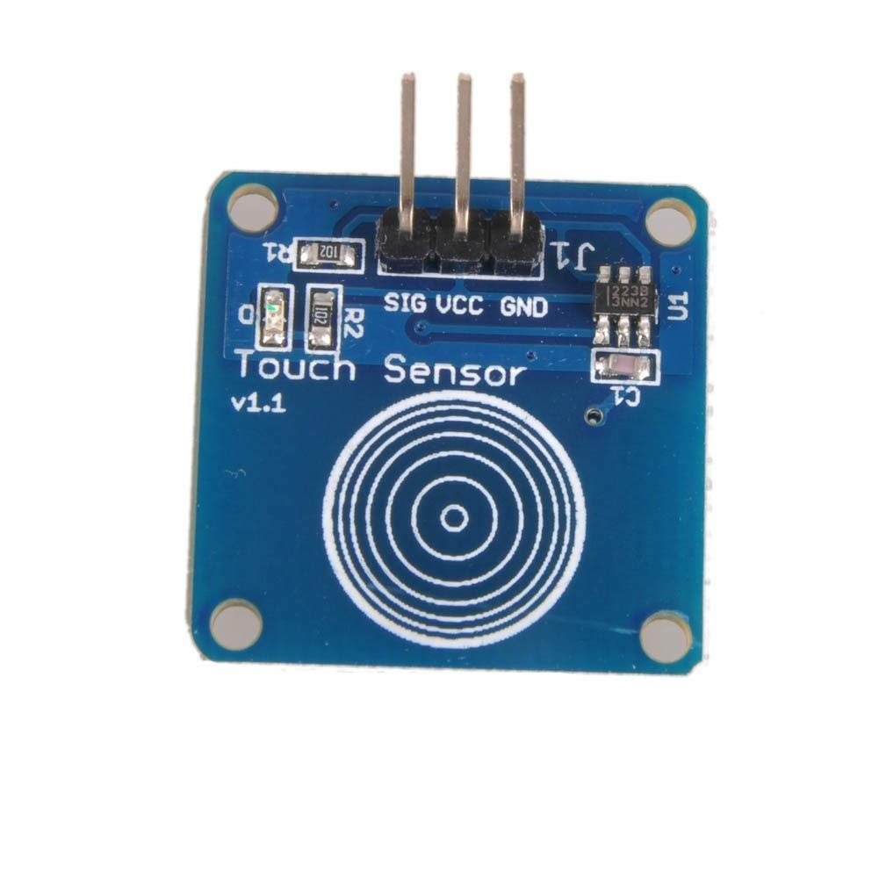
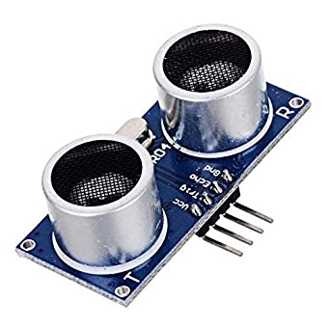
Ultrasonic Sensor
Touch Sensor

Slide 11
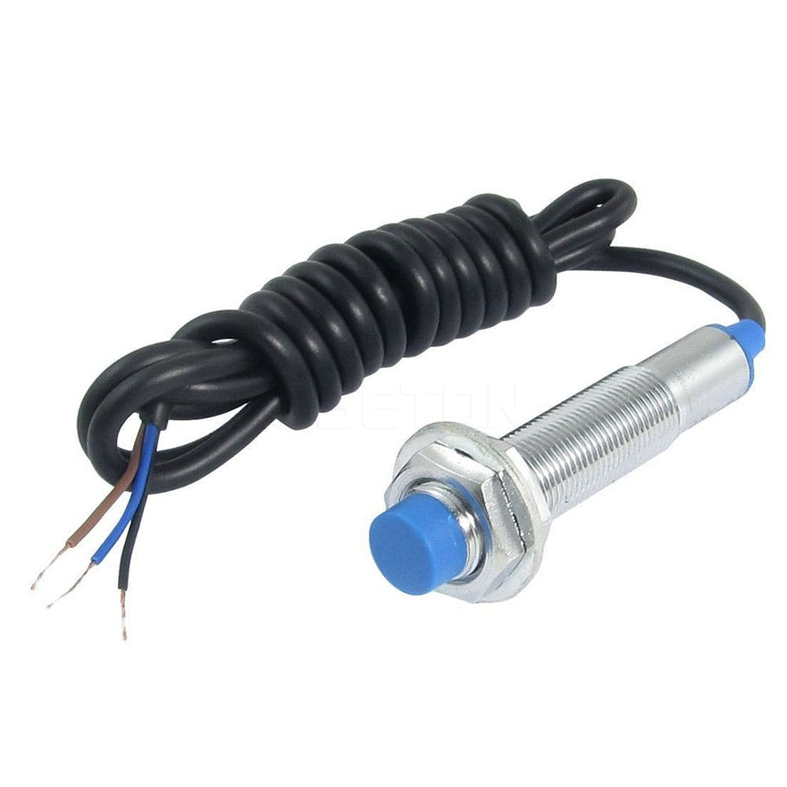
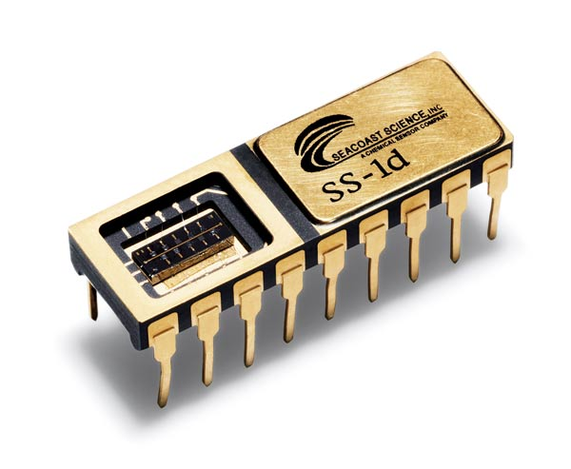
Proximity Sensor
Chemical Sensor

Slide 12
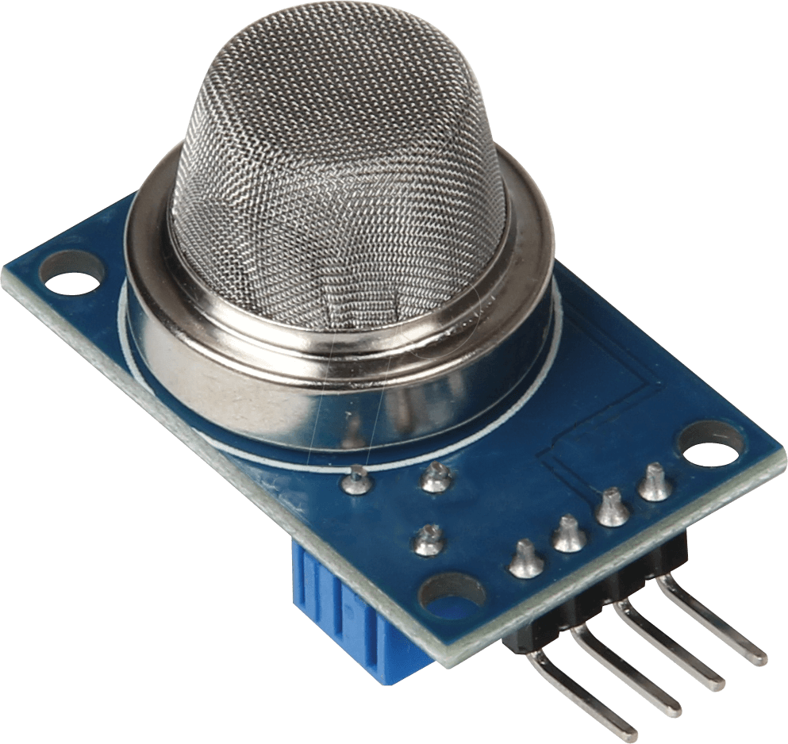
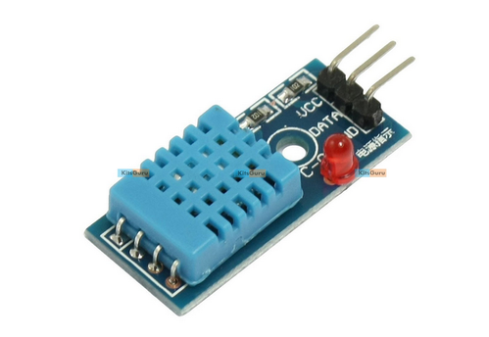
Gas Sensor
Humidity Sensor

Slide 13
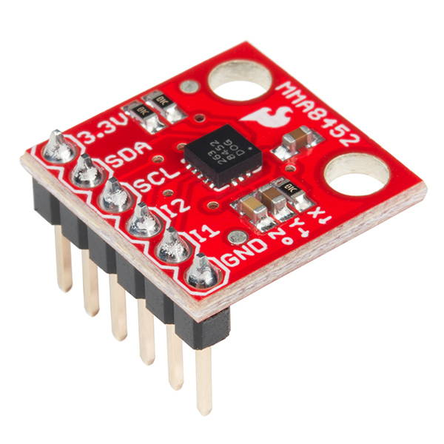
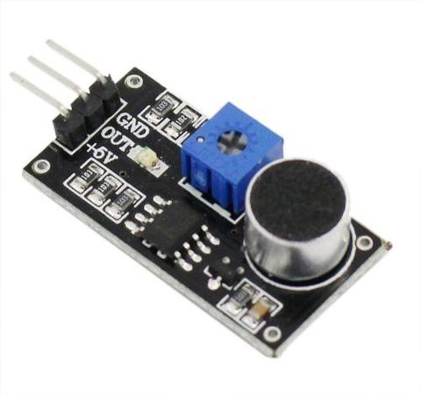
Acceleration Sensor
Sound Sensor

Slide 14
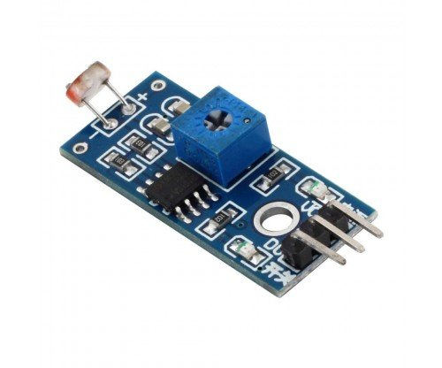
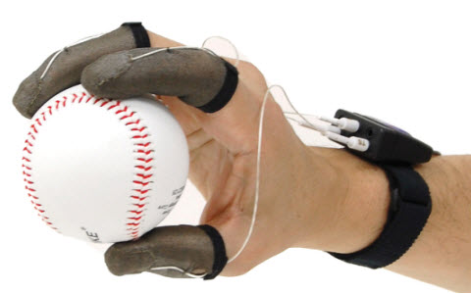
Light Sensor
Tactile Sensor

Slide 15
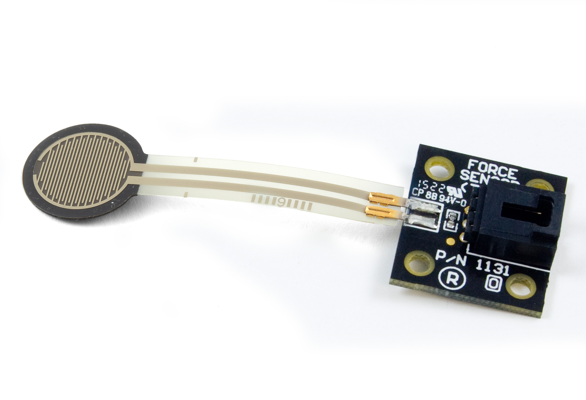
Force Sensor

